Slide 1
Intelligent Post-Lock Down Management system For Public Transport
Team leader :Souravsing Pardeshi
Team Member : Ashwini Ghone

Slide 2
Abstract:
To deal with the challenge of ensuring both efficient mobility and Social-Distancing , We got a brilliant solution .
Our solution suggests to cut down the occupancy of public transporting medium to one third after lockdown.
And we also need to use smart reservation system to maintain the social distancing inside the transport medium.
All the payment for fair should be done cashless by digital payment medium.
The work of the conductor is only to manage the crowd inside the bus or medium.

Slide 3
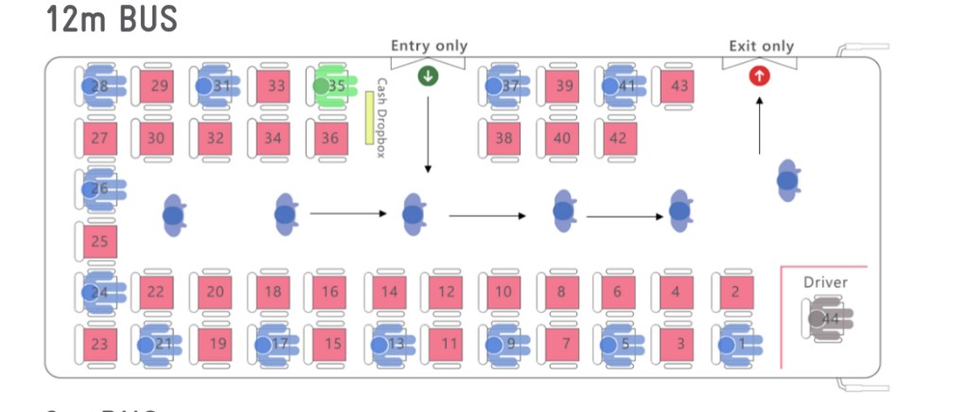
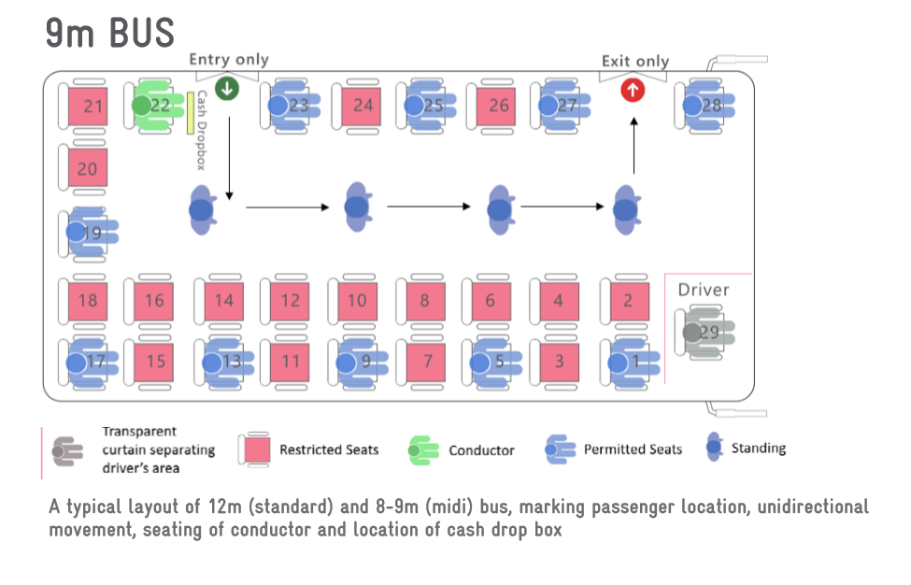
Below images illustrates the reservation of bus (12m standard and 9m mini bus )after lockdown

Slide 4
.
Authority should encourage digital ticketing by using smart card or mobile phones. In the absence of any such digital facility with the authority, they can utilise the service of various start-ups providing similar services, (paytm, chalo etc.)
And work from home should be implemented as much as possible which will also lower the load on public transport medium’s.
Passengers do not allowed to travel without mask .
This may cause crowd at bus stops to counter that we suggest to have different work and operations hours/days for high demand areas .

Slide 5
The Smart Reservation System
Smart reservation system should be made compulsory for public transport medium.
This smart reservation system will work on an algorithm which will assign seats for each reservation by mapping all seats and considering social distancing between all reserved seats and also utilising the space inside the bus.
In this reservation system reserver will not be able to see his/her seating arrangement till all reservations are done and bus (mini or standard) is assigned.
In this system one cannot book a custom seat (which option is available now on online reservation system).
By checking number’s of reservation’s system will assign bus for root (if reservations are less mini bus will be assigned else standard bus will be assigned) which will utilise the transportation system.
And for more crowded stops standard buses will be assigned while for normal crowd mini buses will be assigned.

